Slide 1

Knowledge-Defined Networking
Baran kaya
Kürşat yaşar
Mehmet ali osman atik
May 16, 2018

Slide 2
OvervIew
Definition of the Problem
Knowledge Plane
Software-Defined Networks (SDN)
Knowledge-Defined Networking (KDN)
Experiments
Conclusion

Slide 3
Problem DescrIptIon
ML techniques can be usable on networks [Clark]
These techniques are not common
Reason: Distributed structure
Software-Defined Networks (SDN) can overcome

Slide 4
KNOWLEDGE PLANE
Networks carries data without knowing the purpose [Clark]
Knowledge plane:
Makes low-level decisions
Deals with changes in the high-level requirements

Slide 5
Software-defıned networks
Networks are complex, hard to maintain and manage [Kreutz]
Every switch/router has data and control plane
SDN uses one centralized control plane
Provides programmable networks

Slide 6
Project Descrıptıon
ML techniques (ie. Deep learning) can be usable with SDN
These methods provides:
Self operable networks
Recommendation system for admins

Slide 7
Software-defıned networks
SDN has 3 different planes
Data, control and management plane
Data plane: packet operations
Control plane: flow operations
Management plane: monitoring the network

Slide 8
knowledge-defıned networks
Knowledge-Defined Network (KDN)
KDN: SDN that uses KP methods (ie. ML)
KDN uses control and management planes to gather data & informantion
ML techniques on data
Decision making & self operable networks

Slide 9
knowledge-defıned networks
Knowledge-Defined Network (KDN) usage areas:
Black box optimization
Feedback systems
Machine learning
Automated network architecture

Slide 10
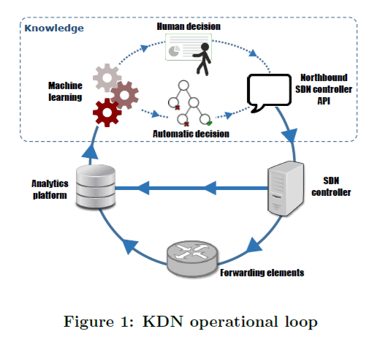
KDN operatıonal loop

Slide 11
ForwardIng Elements & SDN Controller → AnalytIcs Platform
Monitors information from data plane and obtain a view of network
Analytıcs Platform → Machıne Learnıng
Analytics Platform gathers data from network and send these data to the ML algorithms

Slide 12
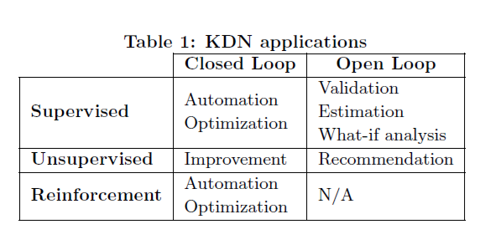
Analytıcs Platform → Machıne Learnıng

Slide 13
Machine Learning → Northbound Controller API
Decision making may be automated or manuel
Closed loop: there is no operator, KP operates automatically by using ML over network log data
Open loop: an operator makes decisions with the aid of KP

Slide 14
Northbound Controller (NC) API → SDN Controller
NC API is a interface tool for monitoring
SDN controller has its own NC API for KDN
SDN Controller → ForwardIng Elements
Applies decisions to the data plane

Slide 15
Routing in an Overlay Network
Edge nodes cannot control the routing but can distribute the traffic among the different links
ML techniques can model the hidden infrastructure network by observing how the output traffic behaves for a given input traffic

Slide 16
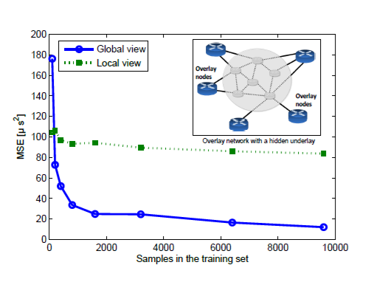
Routing in an Overlay Network (Experıment)
Aim: network can be modelled with ML techniques, delay of network
ANN is trained with traffic and routing configuration and average delay as output

Slide 17
Resource Management with KDN
Network functions can be implemented other than switches and routers with Network Function Virtualization (NFV)
These are called Virtual Network Functions (VNF)
ML methods can learn from the traffic of network and operate the VNFs
VNF resource management can operable without touching the network

Slide 18
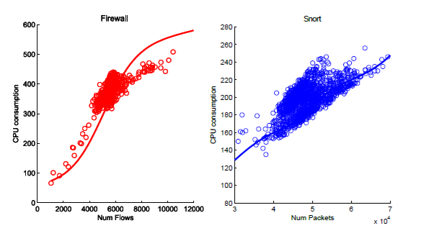
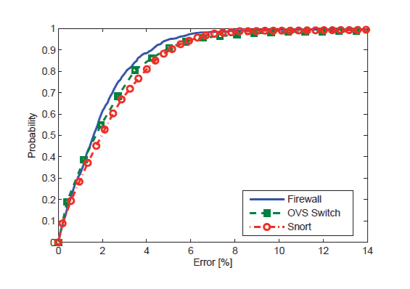
Resource Management experıments

Slide 19
5G networks
5G network is already (wireless) SDN
5G network is reinforced with NFV
Easy to apply KDN over it
Dynamic routing algorithms can be used to increase physical layer throughput

Slide 20
CHALLENGES and CONCLUSIONS
New ML techniques
Non-deterministic networks
New skills for Network Engineers
High quality datasets
Inter-disciplinary work

Slide 21
REFERENCES
[Mestres] A. Mestres et al., “Knowledge-defined networking”, ACM SIGCOMM Computer Communication Review, vol. 47.3, pp. 2-10, 2017.
[Clark] Clark, D., et al. “A knowledge plane for the Internet.” Conf. on Applications, technologies, architectures, and protocols for computer communications, ACM, 2003.
[Kreutz] Kreutz, D., et al. “Software-defined networking: A comprehensive survey.” Proceedings of the IEEE, vol. 103.1, pp. 14-76, 2015.

Slide 22
THANK YOU
FOR LISTENING

Slide 23
QUESTIONS ?

